Slide 1
Developing a Robust EMG-Based Gesture Classification System
Md Shahriar Kabir
Doctoral Instructional Assistant Dept. of Computer Science
Texas State University
Mayesha Maliha Rahman Mithila
Doctoral Instructional Assistant Dept. of Computer Science
Texas State University

Slide 2
Overview
Introduction
Dataset Overview
Methodology
Results and analysis
Conclusion

Slide 3
Introduction
EMG technology captures electrical signals from muscle fibers, crucial for controlling prosthetic devices and assessing muscular disorders.
Accurate interpretation of these signals to determine specific hand gestures poses a significant challenge, requiring advanced machine learning techniques.
This project explores the application of deep learning models to improve the classification accuracy of static hand gestures using EMG data.
Utilizing a dataset of gestures performed by 36 subjects, the study evaluates the effectiveness of various machine learning architectures including LSTM, CNN1D, and Transformers.

Slide 4
Dataset Overview
The dataset consists of raw EMG data captured using the MYO Thalmic bracelet, equipped with eight sensors around the forearm.
Data includes recordings from 36 subjects who performed a series of static hand gestures, providing a comprehensive range for analysis.
Each gesture recording consists of a three-second execution followed by a three-second pause, ensuring clear segmentation for classification.
The dataset features eight distinct classes, representing different hand gestures and positions, with approximately 40,000 to 50,000 recordings per channel and no missing values.

Slide 5
Methodology
Employed four different deep learning architectures: Long Short-Term Memory networks (LSTM), 1D Convolutional Neural Networks (CNN1D), Vision Transformer (ViT), and Swin Transformers to classify EMG gestures.
Implemented robust preprocessing techniques including normalization and data segmentation into fixed-length sequences to standardize input data for model training.
Utilized overlapping window approach in data preprocessing to enhance data continuity and maintain temporal context between consecutive samples.
Applied advanced machine learning techniques such as class weighting and hyperparameter tuning to address challenges like class imbalance and model overfitting.

Slide 6
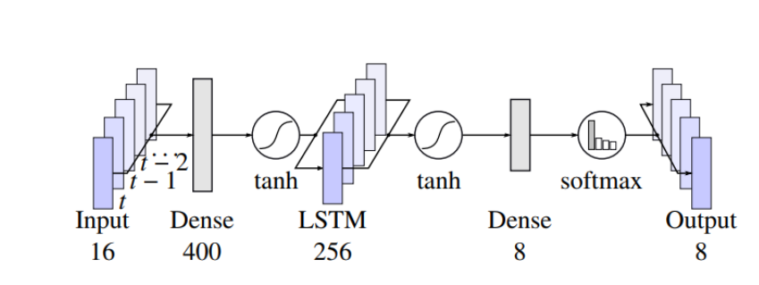
LSTM (Long Short-Term Memory networks)
Fig 1: Structure of the LSTM used as the classifier model, with a one-to-one input-output classification configuration. [1]

Slide 7
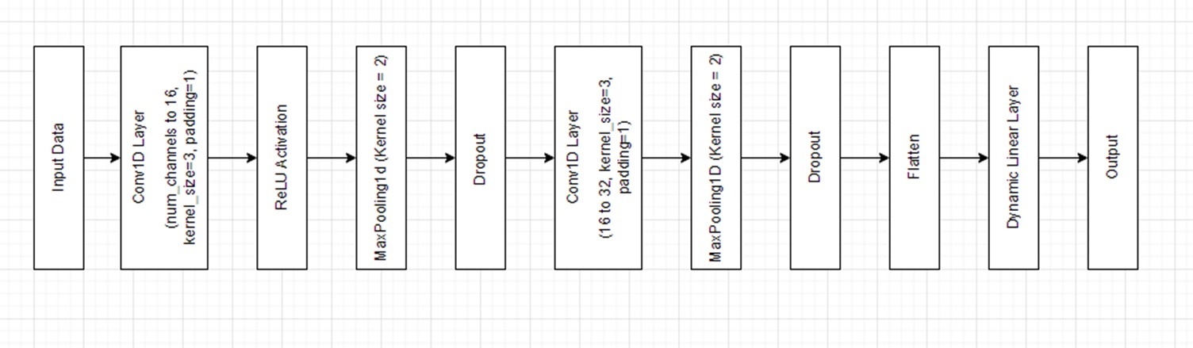
1D CNN
Fig 2: Block diagram of the 1D CNN model [2]

Slide 8
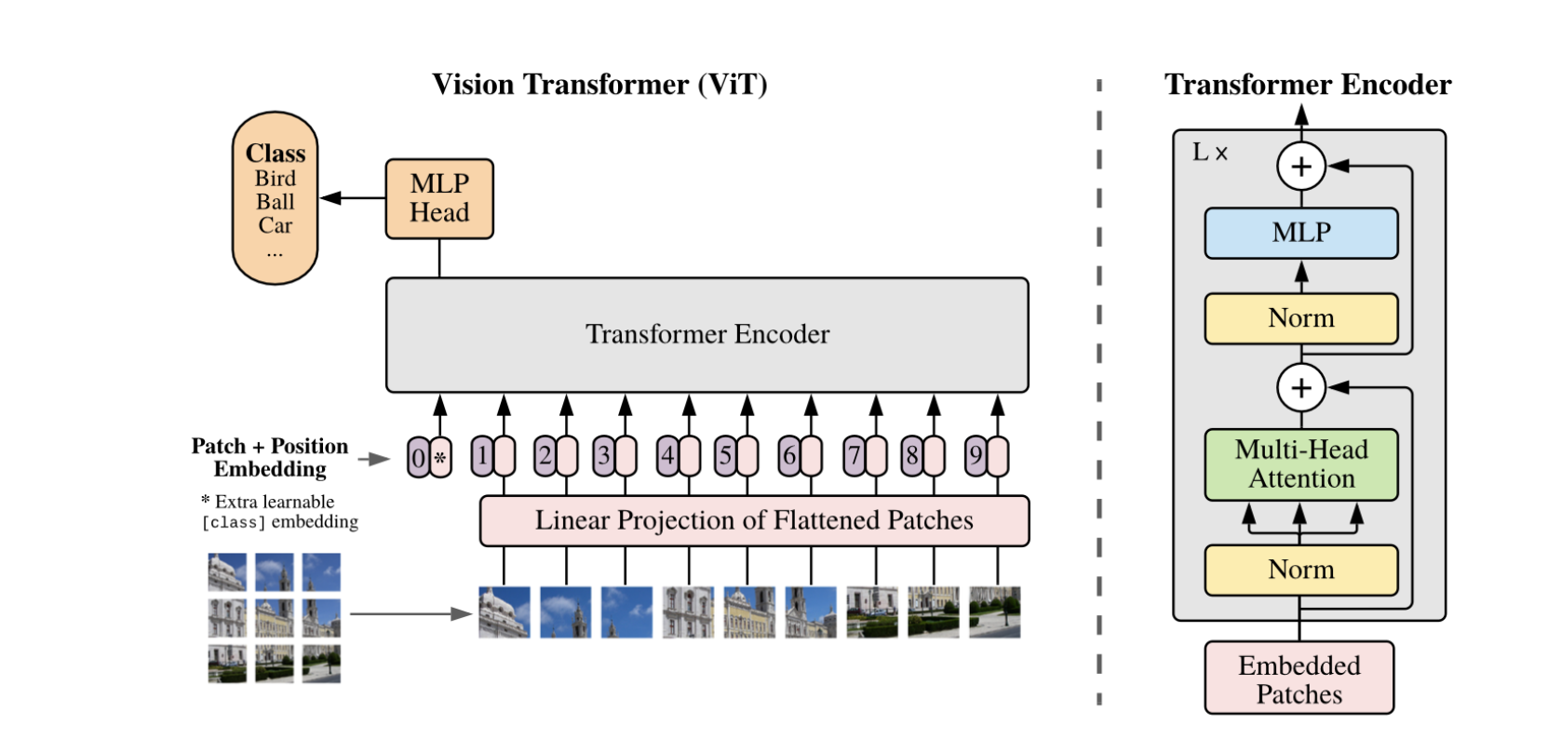
Vision Transformer
Fig 3: Basic implementation of ViT with patch embedding and positional encoding [3]

Slide 9
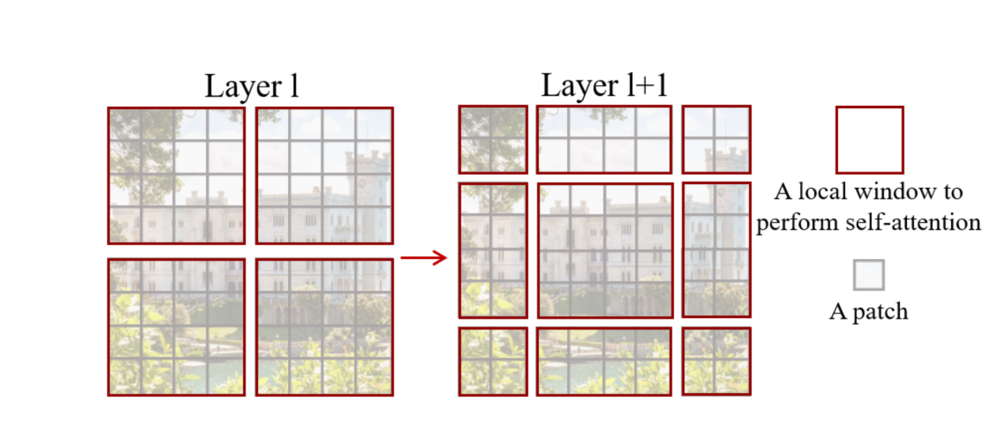
Swin Transformer
Fig 4: Shifting window approach in Swin transformer [4]

Slide 10
Results
Models evaluated using metrics like :
Accuracy,
Precision,
Recall, and
F-1 score,
with continuous monitoring and validation on unseen data to ensure robustness and generalizability.

Slide 11
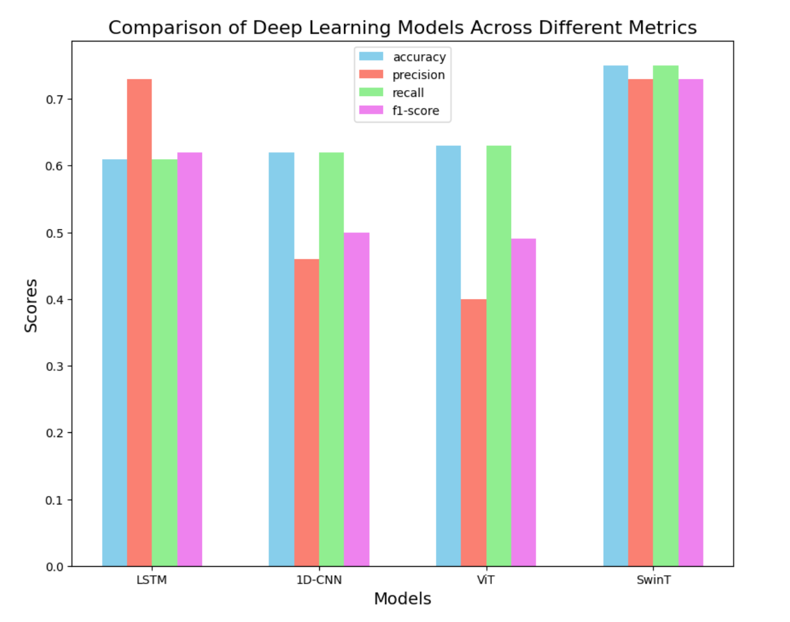
Results
Fig 5: Performance of different models on EMG gesture dataset

Slide 12
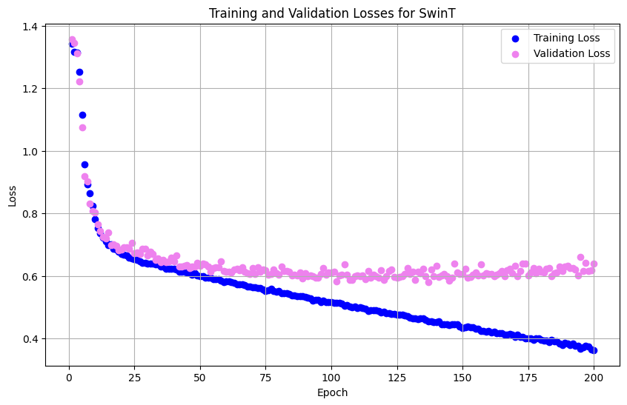
Results
Fig 7: Loss analysis of Swin transformer over different epochs

Slide 13
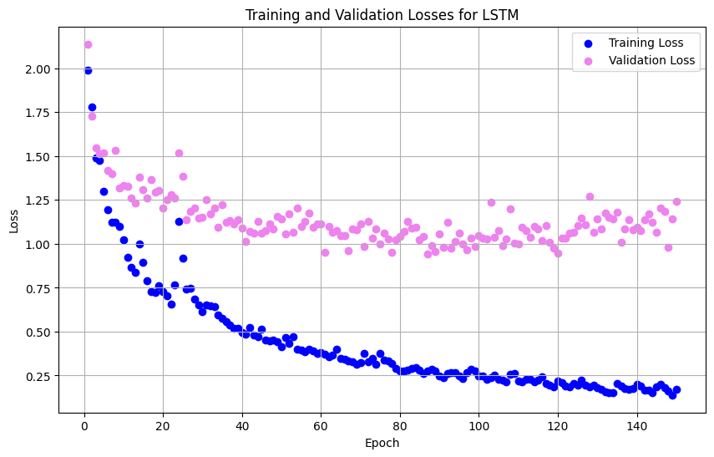
Results
Fig 7: Loss analysis of LSTM over different epochs

Slide 14
Result Analysis
LSTM Classifier: Attained high accuracy in training but exhibited significant overfitting on the test set, suggesting a necessity for improved generalization strategies.
CNN Classifier: Maintained consistent performance during training but encountered difficulties in generalization, especially concerning less represented classes, prompting the need for further enhancements.
Vision Transformer (ViT): Utilized self-attention mechanisms to capture long-range dependencies, yet faced challenges in generalizing across various gesture types, necessitating meticulous parameter adjustments.
Swin Transformer: Displayed superior generalization compared to LSTM but struggled with imbalanced data, particularly with minority classes like class 1.

Slide 15
Conclusion
The study establishes a solid foundation for refining and deploying advanced deep learning models to accurately classify EMG-based gestures.
Addressing challenges such as class imbalance and model overfitting through targeted improvements can significantly enhance model performance and reliability.
There is considerable potential to expand these models' applications in healthcare and rehabilitation, improving the functionality and responsiveness of assistive technologies.
Future refinements and the implementation of proposed enhancements promise to elevate the effectiveness of these models in real-world settings.

Slide 16
References
UCI Machine Learning Repository: EMG Data for Gestures. Available online: https://archive.ics. uci.edu/dataset/481/emg+data+for+gestures.
Simão, M., Neto, P., & Gibaru, O. (2019). EMG-based online classification of gestures with recurrent neural networks. Pattern Recognition Letters, 128, 45-51.
Karnam, N. K., Dubey, S. R., Turlapaty, A. C., & Gokaraju, B. (2022). EMGHandNet: A hybrid CNN and Bi-LSTM architecture for hand activity classification using surface EMG signals. Biocybernetics and biomedical engineering, 42(1), 325-340.
Dosovitskiy, A., Beyer, L., Kolesnikov, A., Weissenborn, D., Zhai, X., Unterthiner, T., Dehghani, M., Minderer, M., Heigold, G., Gelly, S., et al. (2020). An Image is Worth 16x16 Words: Transformers for Image Recognition at Scale. arXiv preprint arXiv:2010.11929.
Liu, Z., Lin, Y., Cao, Y., Hu, H., Wei, Y., Zhang, Z., Lin, S., & Guo, B. (2021). Swin Transformer: Hierarchical Vision Transformer using Shifted Windows. arXiv preprint arXiv:2103.14030.

